Slide 1
Health Care System

Slide 2
Technologies
Java 8
Spring Boot
Spring Security
Angular | React
PostgreSQL | MYSQL
Maven | Gradle

Slide 3
Problem Statement
To Create an Application for online appointment at Diagnostic Health Care center.
Customer can Login/Signup to application.
Customer should be able to take appointment for test.
Customer should be able view appointment status
Admin should be able to approve or reject the appointment.
Admin can add/modify/view/remove diagnostic Centre from database.
Admin can add/modify/view/remove diagnostic Test from database.

Slide 4
Plan
Design
Generate the skeleton as per class design provided
TDD approach
Identify test cases for each module
Write Failing Test cases
Convert the Test Cases in GREEN
Implement the case study in incremental manner

Slide 5
Modules
Login Module
Appointment Module
Diagnostic Center module
Admin Module
Diagnostic Test Module

Slide 6
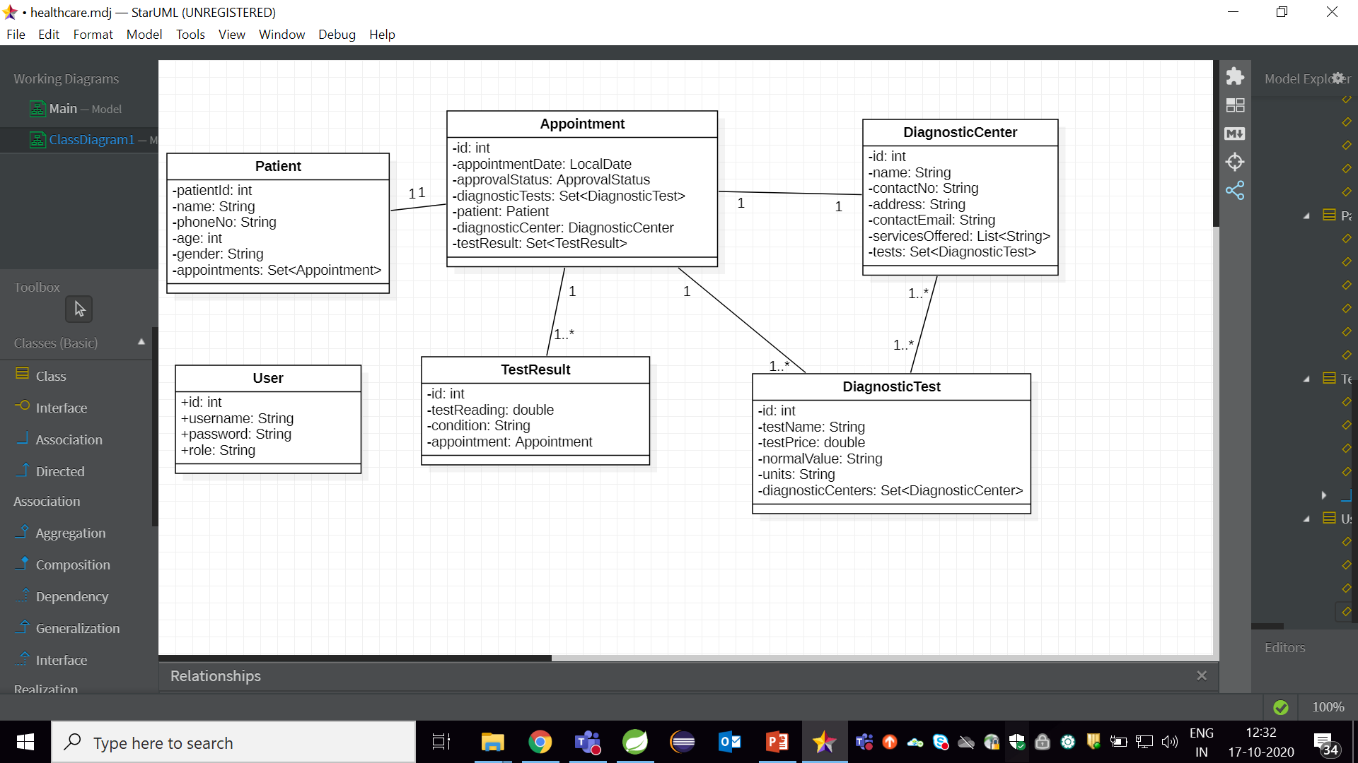
Class Design [POJO Classes]

Slide 7
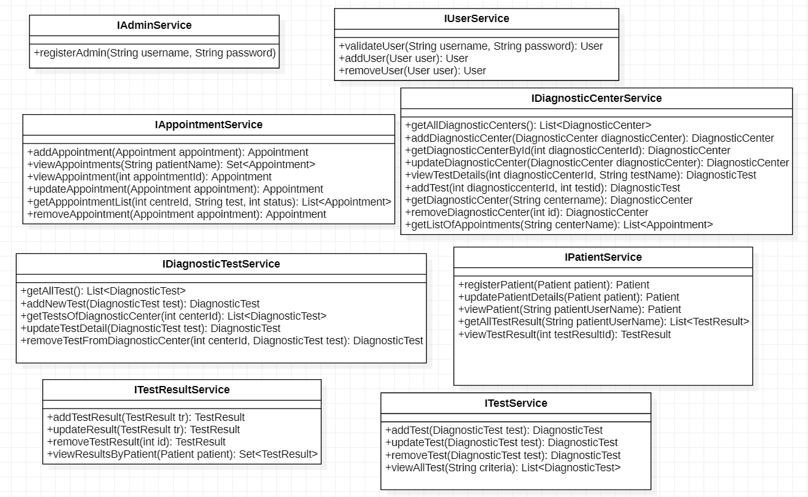
Class Design [Service Interface]

Slide 8
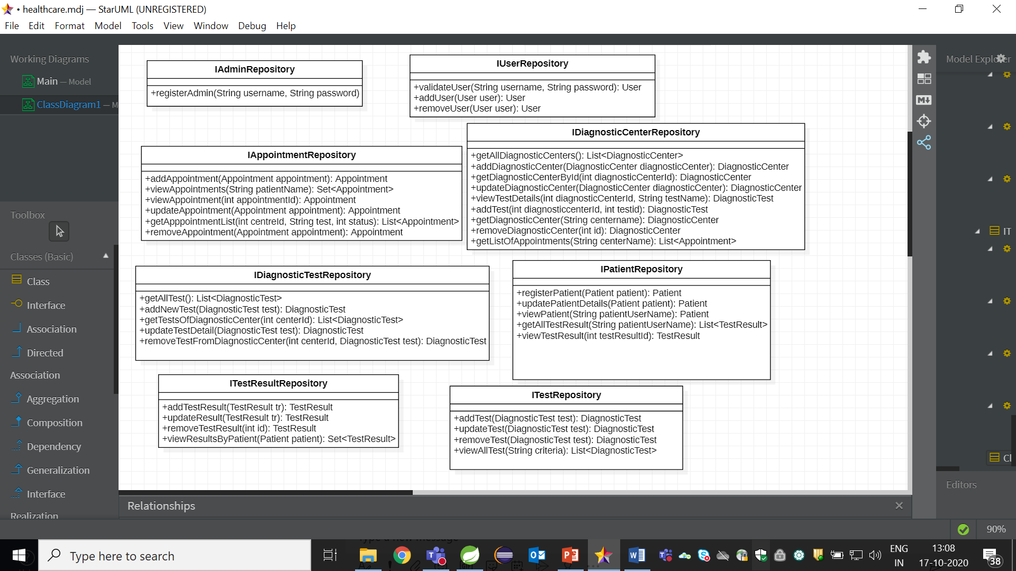
Class Design [Repository]

